Slide 1
Twitter Mining with Python
Dajun Tian and Connie Zabarovskaya
Center for Biomedical Informatics
Washington University in St. Louis

Slide 2
What you will learn
Examples of research using Twitter
How to create a developer account with Twitter
How to import Twitter data into Python
Understanding Twitter data and what JSON format is
How to search Twitter data
How to analyze Twitter data
How to graph results
How to export results into CSV format

Slide 3
Research Using Twitter
“What can we learn about the Ebola outbreak from tweets?” (pubmed/26042846)
Disease detection or public opinion reflection? Content analysis of tweets, other social media, and online newspapers during the measles outbreak in The Netherlands in 2013.: (pubmed/26013683)
Tweet content related to sexually transmitted diseases: no joking matter. (pubmed/25289463)
Discovering health topics in social media using topic models.: (pubmed/25084530)
Notes:
Based on analysis of Twitter data related to Ebola virus, the first study concluded that “social media content can be used to support and enhance existing early warning systems, because fear and knowledge deficits drive epidemics. So outbreak alerts must accompany population-specific and literacy-appropriate health education messages for intervention and outbreak control.”
The second study analyzed whether the tweet trend reflected public opinion on vaccination requirements or the actual reported measles cases, and their results show that “social media messages was related more strongly to the number of online news articles than to the number of reported measles cases, and the leading sentiment was frustration regarding people who do not vaccinate for religious reasons.”
The third study concluded that “almost 9/10 of tweets on STDs (chlamydia and HIV) were of serious content, and many of the tweets that were re-tweeted were facts”, but still social media should be used to disseminate more correct information about STDs as opposed to common jokes.
Overall, by looking at just these 4 examples, we may say that studies that use Twitter data can help identify issues in knowledge and understanding of health related issues by masses and how organizations may choose to intervene to spread more information and educate people about health facts and prevention of diseases, using Social Media, thus potentially improving public health.

Slide 4
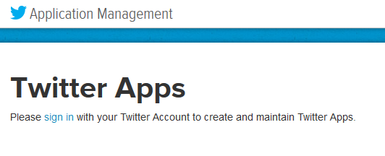
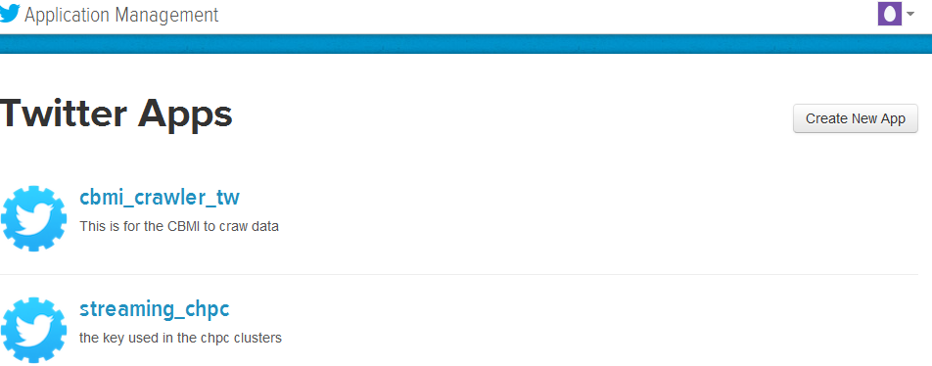
How to create a developer account with Twitter
1
Go to: https://apps.twitter.com/
Sign in using your Twitter credentials
Click button to create new App (Application)
Fill out the new App form (see next slide)
3

Slide 5
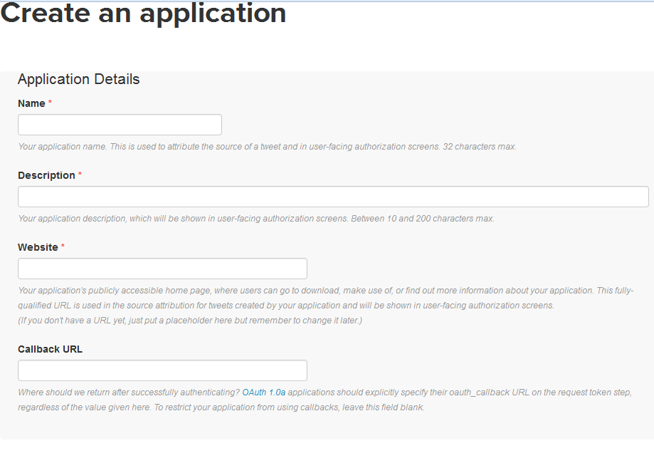
How to create a developer account with Twitter (cont.)
Any URL relevant to you (e.g. biography page or social media page)
Notes:
Essentially you are creating an application that will pull data from Twitter using read access, however, more complex apps can also be used to write data to Twitter.
If you want to create an app, you have to associate your phone number with the account, so you can enter a code to confirm your application.

Slide 6
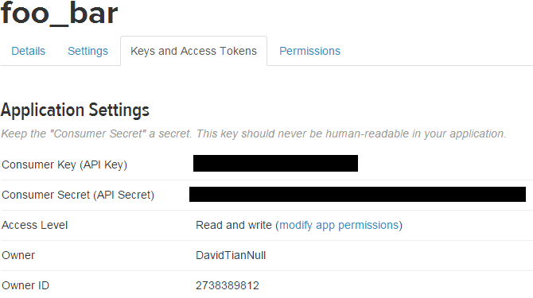
How to create a developer account with Twitter (cont.)
Note your Consumer Key and Consumer Secret
APP_KEY
APP_SECRET
Notes:
The two blacked out series of numbers will be used uniquely by your application, so you should not hard-code them into your application outside of this tutorial. You will use these numbers when building a query for API. API will be explained in the next slide

Slide 7
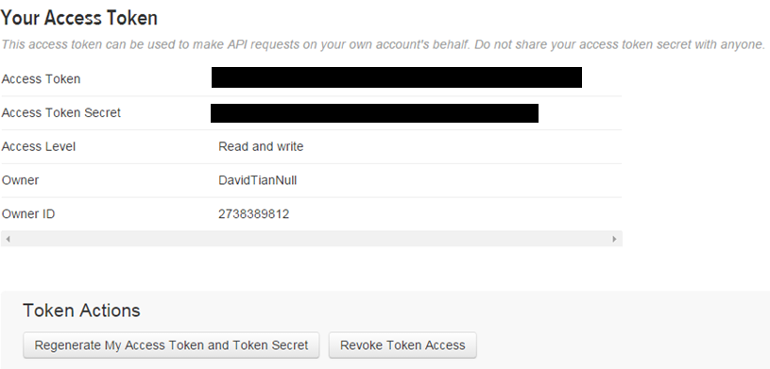
How to create a developer account with Twitter (cont.)
Note your Access Token and Access Token Secret
OAUTH_TOKEN
OAUTH_TOKEN_SECRET

Slide 8
Twitter API Types
API: application program interface, or in simple terms accessing a program using functions
REST APIs
programmatic access to read and write Twitter data
Streaming API
monitor or process Tweets in real-time
Parameters: track, locations, follow, delimited, stall_warnings
Notes:
This tutorial will focus only on Streaming API
The limitation of REST API is that there is a limit on how many times you can access twitter data within a period of time.
But we can keep the streaming API open as long as we need it to collect data real-time.
If you filter by track, you cannot filter by location at the same time (it works as an OR statement). You can extract location data and then filter it out.

Slide 9
How to import Twitter data into Python
Import TwythonStreamer and json packages
Save twitter credentials into variables
Create a new class based on TwythonStreamer class with default or adjusted parameters
Initiate a connection to Twitter using the new class, filtering tweets based on either track, location, or source
Save tweets, while they come in through the connection
Optionally, save tweets into a json or text file, and then read in the json file or txt file into Python to analyze it

Slide 10
A Single Tweet in JSON Format
{"contributors": null, "truncated": false, "text": "Rue de la Fraternity 1/1\nTownscape acrylic painting\nSOLD available print on canvas\nhttp://t.co/dxIVBvJvMG http://t.co/u2SXS2enjm", "in_reply_to_status_id": null, "id": 544588839302340608, "favorite_count": 0, "source": "<a href=\"http://twitter.com\" rel=\"nofollow\">Twitter Web Client</a>", "retweeted": false, "coordinates": null, "timestamp_ms": "1418675071918", "entities": {"symbols": [], "media": [{"expanded_url": "http://twitter.com/bobheatly/status/544588839302340608/photo/1", "display_url": "pic.twitter.com/u2SXS2enjm", "url": "http://t.co/u2SXS2enjm", "media_url_https": "https://pbs.twimg.com/media/B47EqdlCEAAgtZG.jpg", "id_str": "544588838731911168", "sizes": {"small": {"h": 340, "resize": "fit", "w": 340}, "large": {"h": 625, "resize": "fit", "w": 624}, "medium": {"h": 600, "resize": "fit", "w": 600}, "thumb": {"h": 150, "resize": "crop", "w": 150}}, "indices": [106, 128], "type": "photo", "id": 544588838731911168, "media_url": "http://pbs.twimg.com/media/B47EqdlCEAAgtZG.jpg"}], "hashtags": [], "user_mentions": [], "trends": [], "urls": [{"url": "http://t.co/dxIVBvJvMG", "indices": [83, 105], "expanded_url": "http://www.bobheatlyartist.com/#!town-/c18r3", "display_url": "bobheatlyartist.com/#!town-/c18r3"}]}, "in_reply_to_screen_name": null, "id_str": "544588839302340608", "retweet_count": 0, "in_reply_to_user_id": null, "favorited": false, "user": {"follow_request_sent": null, "profile_use_background_image": true, "default_profile_image": false, "id": 2382261656, "verified": false, "profile_image_url_https": "https://pbs.twimg.com/profile_images/443045908637155329/_n-9wh94_normal.jpeg", "profile_sidebar_fill_color": "DDEEF6", "profile_text_color": "333333", "followers_count": 1336, "profile_sidebar_border_color": "000000", "id_str": "2382261656", "profile_background_color": "C0DEED", "listed_count": 43, "profile_background_image_url_https": "https://pbs.twimg.com/profile_background_images/444501687168806912/R53r3-il.jpeg", "utc_offset": null, "statuses_count": 27551, "description": "ARTIST and award winning design educator", "friends_count": 2001, "location": "Joplin MO", "profile_link_color": "080808", "profile_image_url": "http://pbs.twimg.com/profile_images/443045908637155329/_n-9wh94_normal.jpeg", "following": null, "geo_enabled": true, "profile_banner_url": "https://pbs.twimg.com/profile_banners/2382261656/1404759282", "profile_background_image_url": "http://pbs.twimg.com/profile_background_images/444501687168806912/R53r3-il.jpeg", "name": "bob heatly", "lang": "en", "profile_background_tile": true, "favourites_count": 801, "screen_name": "bobheatly", "notifications": null, "url": "http://www.bobheatlyartist.com/wwwhttp://www.bobheatlyartist..bobheatlyartist.com/#!slide-show/c1hlx", "created_at": "Mon Mar 10 14:56:57 +0000 2014", "contributors_enabled": false, "time_zone": null, "protected": false, "default_profile": false, "is_translator": false}, "geo": null, "in_reply_to_user_id_str": null, "possibly_sensitive": false, "lang": "en", "created_at": "Mon Dec 15 20:24:31 +0000 2014", "filter_level": "none", "in_reply_to_status_id_str": null, "place": {"country_code": "US", "url": "https://api.twitter.com/1.1/geo/id/504ec2713c70e7a3.json", "country": "United States", "place_type": "city", "bounding_box": {"type": "Polygon", "coordinates": [[[-94.579066, 37.019415], [-94.579066, 37.173623], [-94.4173905, 37.173623], [-94.4173905, 37.019415]]]}, "full_name": "Joplin, MO", "attributes": {}, "id": "504ec2713c70e7a3", "name": "Joplin"}, "extended_entities": {"media": [{"expanded_url": "http://twitter.com/bobheatly/status/544588839302340608/photo/1", "display_url": "pic.twitter.com/u2SXS2enjm", "url": "http://t.co/u2SXS2enjm", "media_url_https": "https://pbs.twimg.com/media/B47EqdlCEAAgtZG.jpg", "id_str": "544588838731911168", "sizes": {"small": {"h": 340, "resize": "fit", "w": 340}, "large": {"h": 625, "resize": "fit", "w": 624}, "medium": {"h": 600, "resize": "fit", "w": 600}, "thumb": {"h": 150, "resize": "crop", "w": 150}}, "indices": [106, 128], "type": "photo", "id": 544588838731911168, "media_url": "http://pbs.twimg.com/media/B47EqdlCEAAgtZG.jpg"}]}}

Slide 11
JSON Format Explained
JSON: JavaScript Object Notation.
JSON is a syntax for storing and exchanging data.
JSON is an easier-to-use alternative to XML.
Dictionary
{ “KEY”: “VALUE” }
{ “NAME”: “JOHN” }
Dictionary containing Array
{ “Employees”: [
{ “FirstName” : “John”, “LastName” : “Doe”},
{ “FirstName” : “Jane”, “LastName” : “Doe”},
]}

Slide 12
JSON in Pretty Format
Sample only:
{
"contributors": null,
"truncated": false,
"text": "Rue de la Fraternity 1\/1\nTownscape acrylic painting\nSOLD available print on canvas\nhttp:\/\/t.co\/dxIVBvJvMG http:\/\/t.co\/u2SXS2enjm",
"in_reply_to_status_id": null,
"id": 5.4458883930234e+17,
"favorite_count": 0,
"source": "<a href=\"http:\/\/twitter.com\" rel=\"nofollow\">Twitter Web Client<\/a>",
"retweeted": false,
"coordinates": null,
"timestamp_ms": "1418675071918",
… }
http://jsonprettyprint.com

Slide 13
Common Analyses of Twitter Data
Sentiment analysis: extracting opinions, emotions, and sentiments as text, and evaluate them as negative or positive
Packages: NLTK, textblob, vaderSentiment
Network analysis: identify important users and important topics
Packages: NetworkX, Graph-tool
Topic modeling: understand the topics the users talk about – e.g. through automatic topic discovery with latent Dirichlet allocation (LDA)
Packages: lda, gensim

Slide 14
Hands-on
Notes:
You can use a multitude of tools for analyzing Twitter data, starting from simple bar charts and line graphs, to more complex geographic map graphs and cluster analysis of text of tweets.

Slide 15
Resources
http://jsonprettyprint.com/
https://docs.python.org/2/library/json.html
https://instagram.com/developer
https://github.com/Instagram/python-instagram
https://dev.twitter.com/
https://twython.readthedocs.org/en/latest/index.html
Analyses: http://tweettracker.fulton.asu.edu/tda/TwitterDataAnalytics.pdf

Slide 16
Thank you!
Questions?

